Slide 1

Restaurant management system
Software engineering project(Group 18)

Slide 2
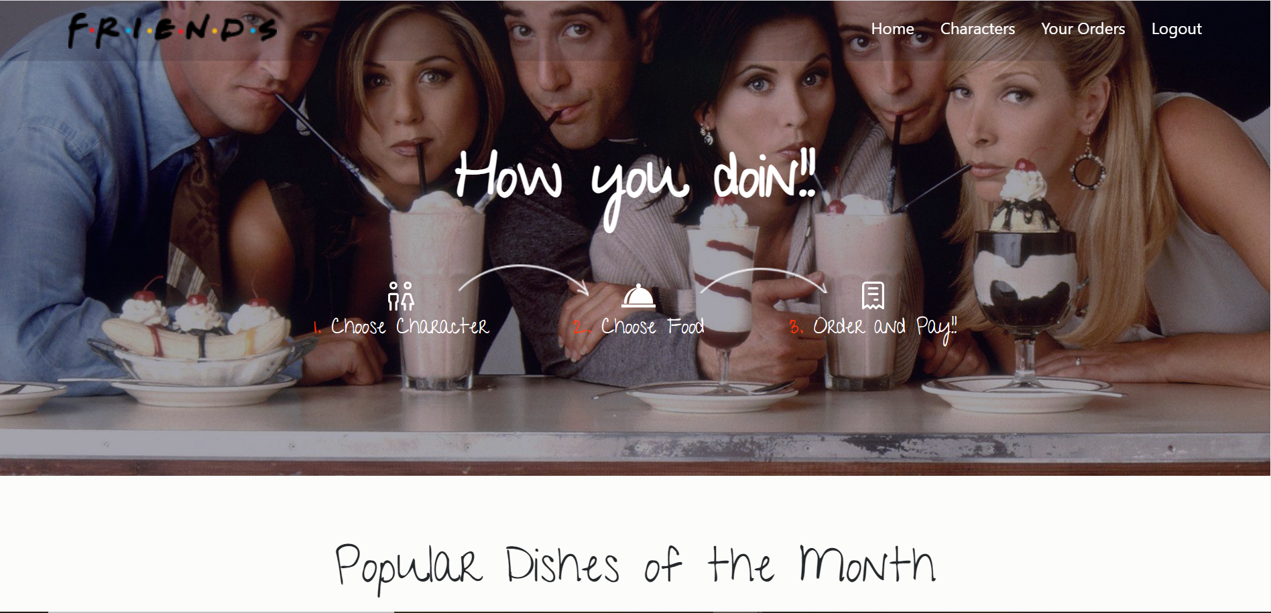
OVERVIEW
The Restaurant Management System helps to manage the restaurant more effectively and efficiently by computerized meal ordering and billing. It facilitates ordering within a traditional restaurant. The customers are able to view the menu, place orders and organise the final bill through their tablets.It provides the best customer service experience via tablet mode. ​

Slide 3
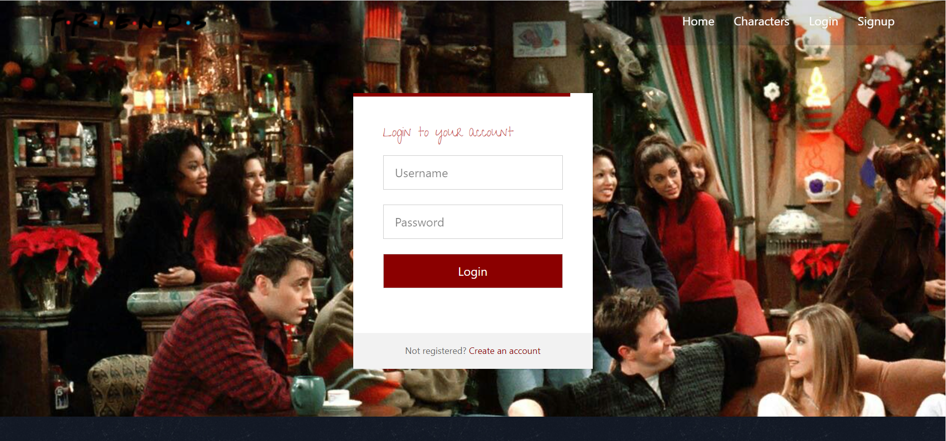
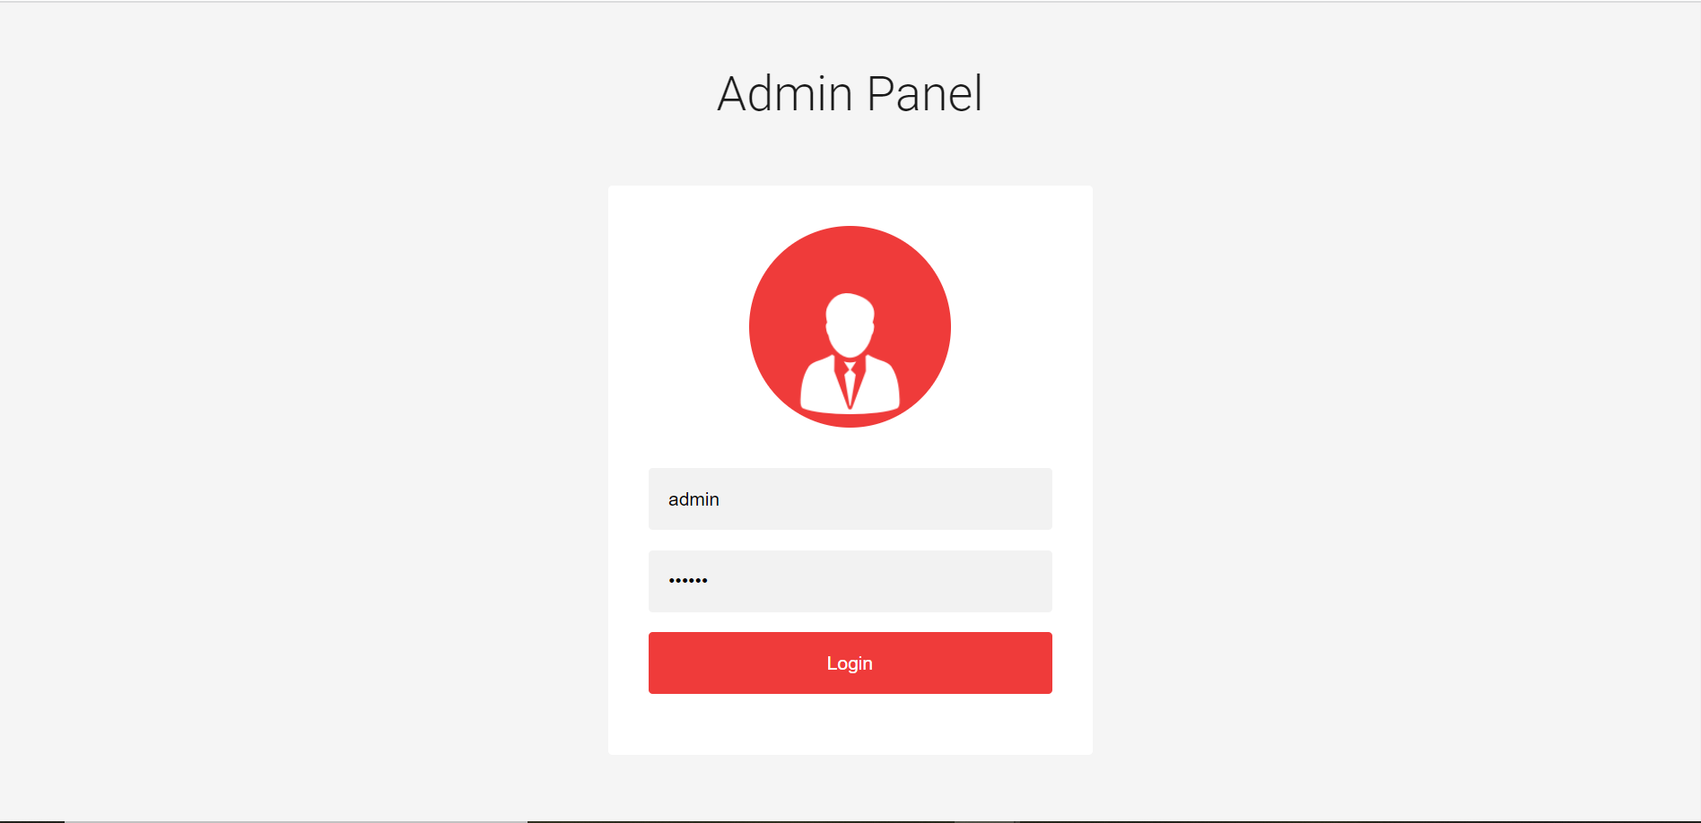
LOGIN
CUSTOMERS
Customers can login using their username and password.If they are not registered they can sign up with their details.
ADMIN
Admin can login with the username and password.​

Slide 4
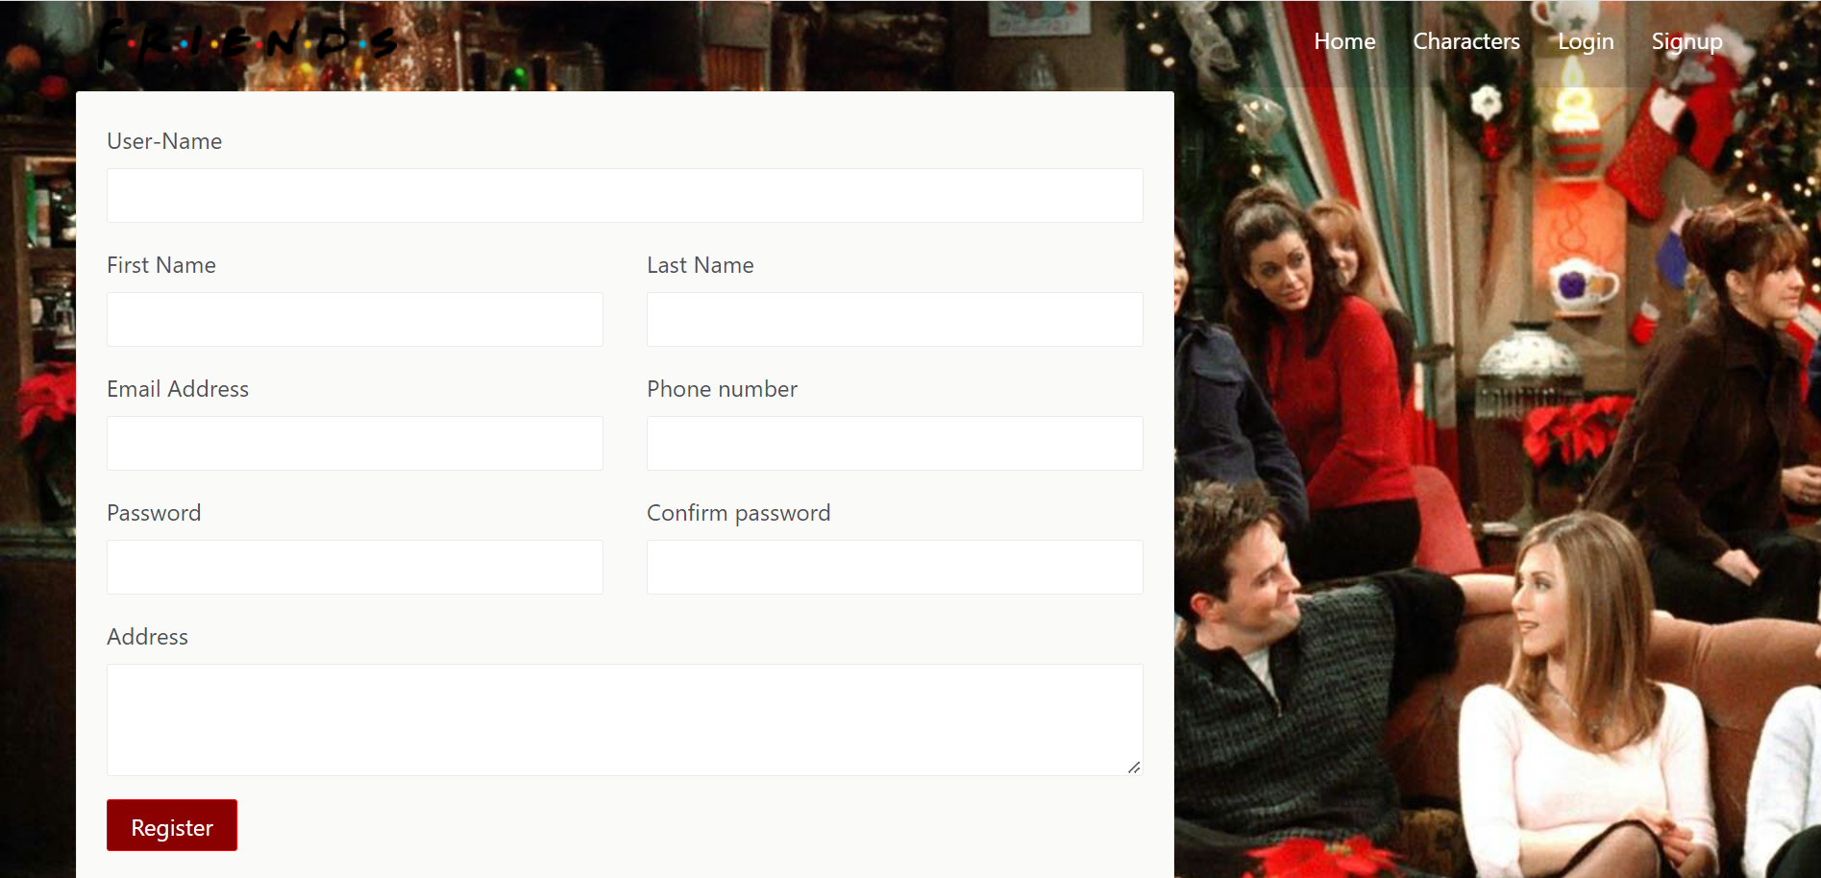
SIGN UP
NEW USERS SIGN UP
SHOLUD ENTER A NEW EMAIL ID ALREADY USED EMAIL ID CANT BE USED AGAIN
PHONE NUMBER MUST BE 10 DIGIT NUMBER
PASSWORD MUST BE >= 6 LETTERS​

Slide 5
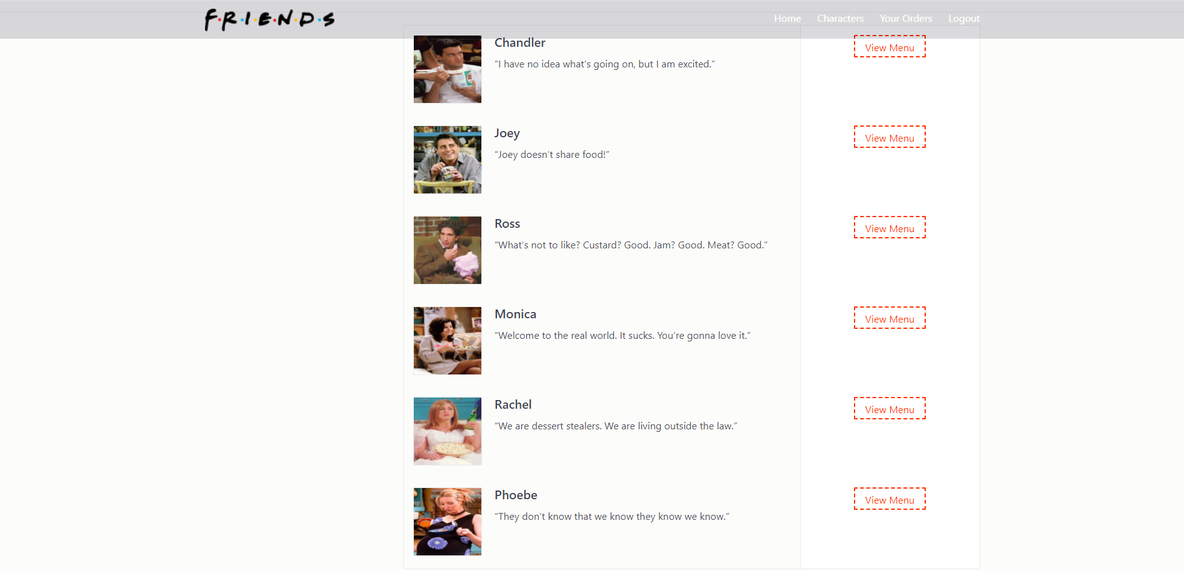
After Logging In Users Get Directed To Main Page From Where They Can Select Their Favourite Food From The Charactered Menu.

Slide 6
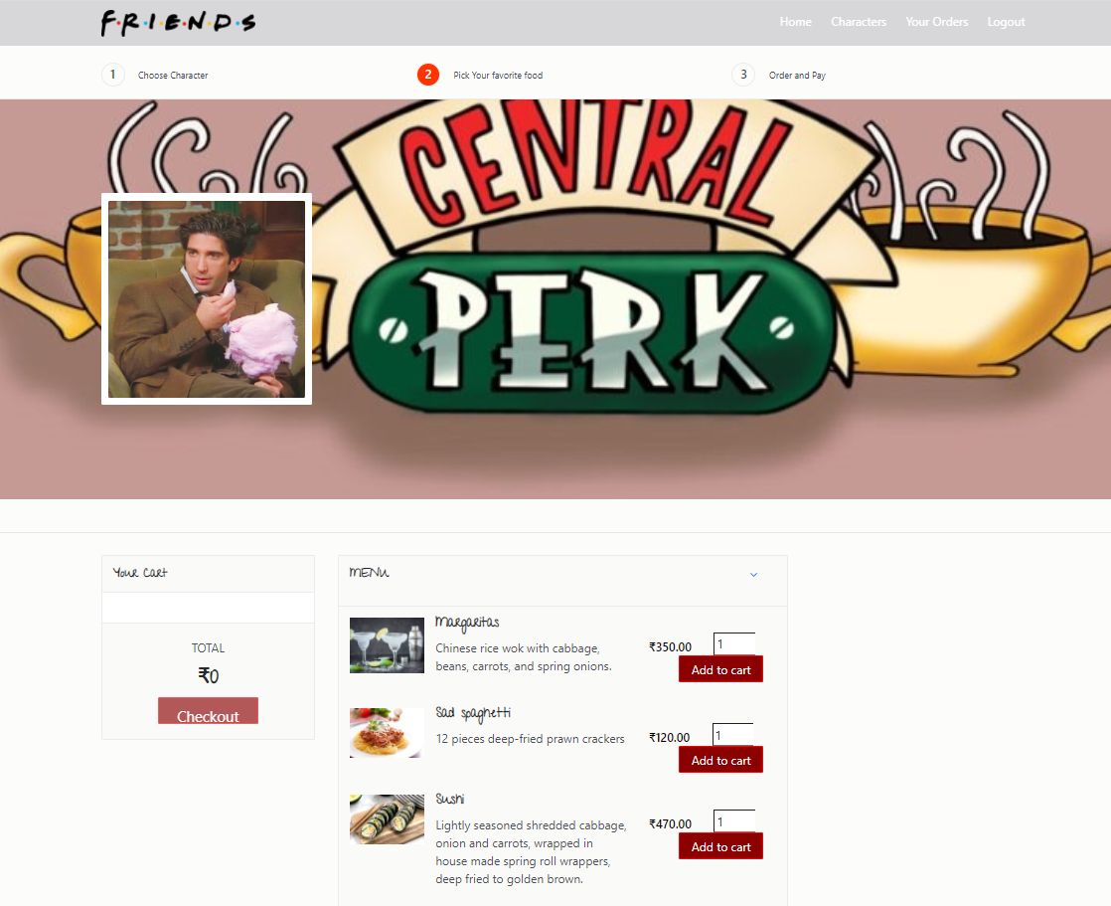
After Selecting A Particular Character They Can Select Food From The Menu

Slide 7
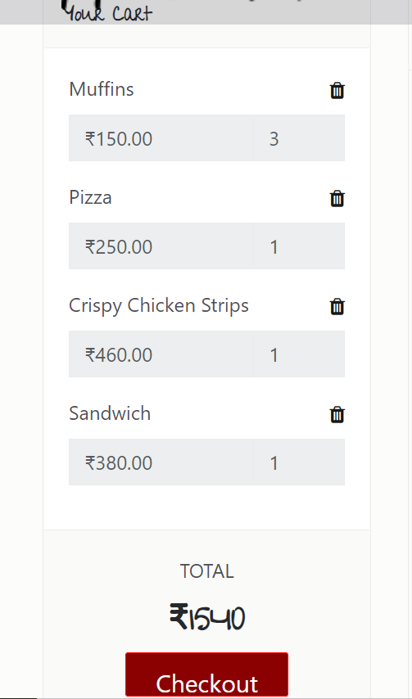
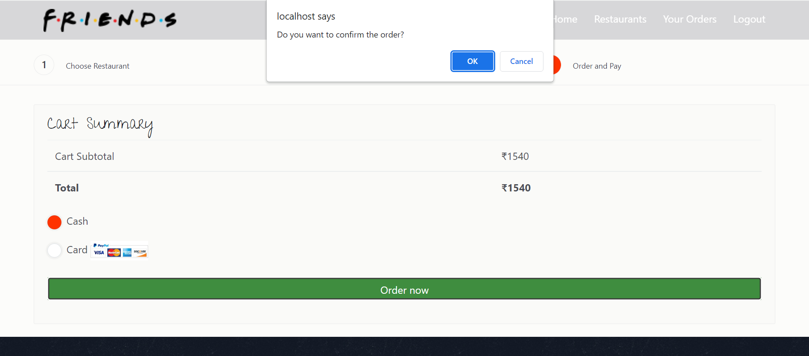
After Adding The Food To The Cart They Must Need To Checkout And It Directs To The Payment Page After Selecting The Mode Of Payment It Asks For The Confirmation Of The Order

Slide 8
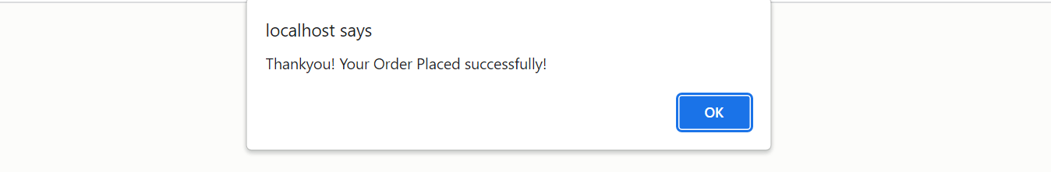
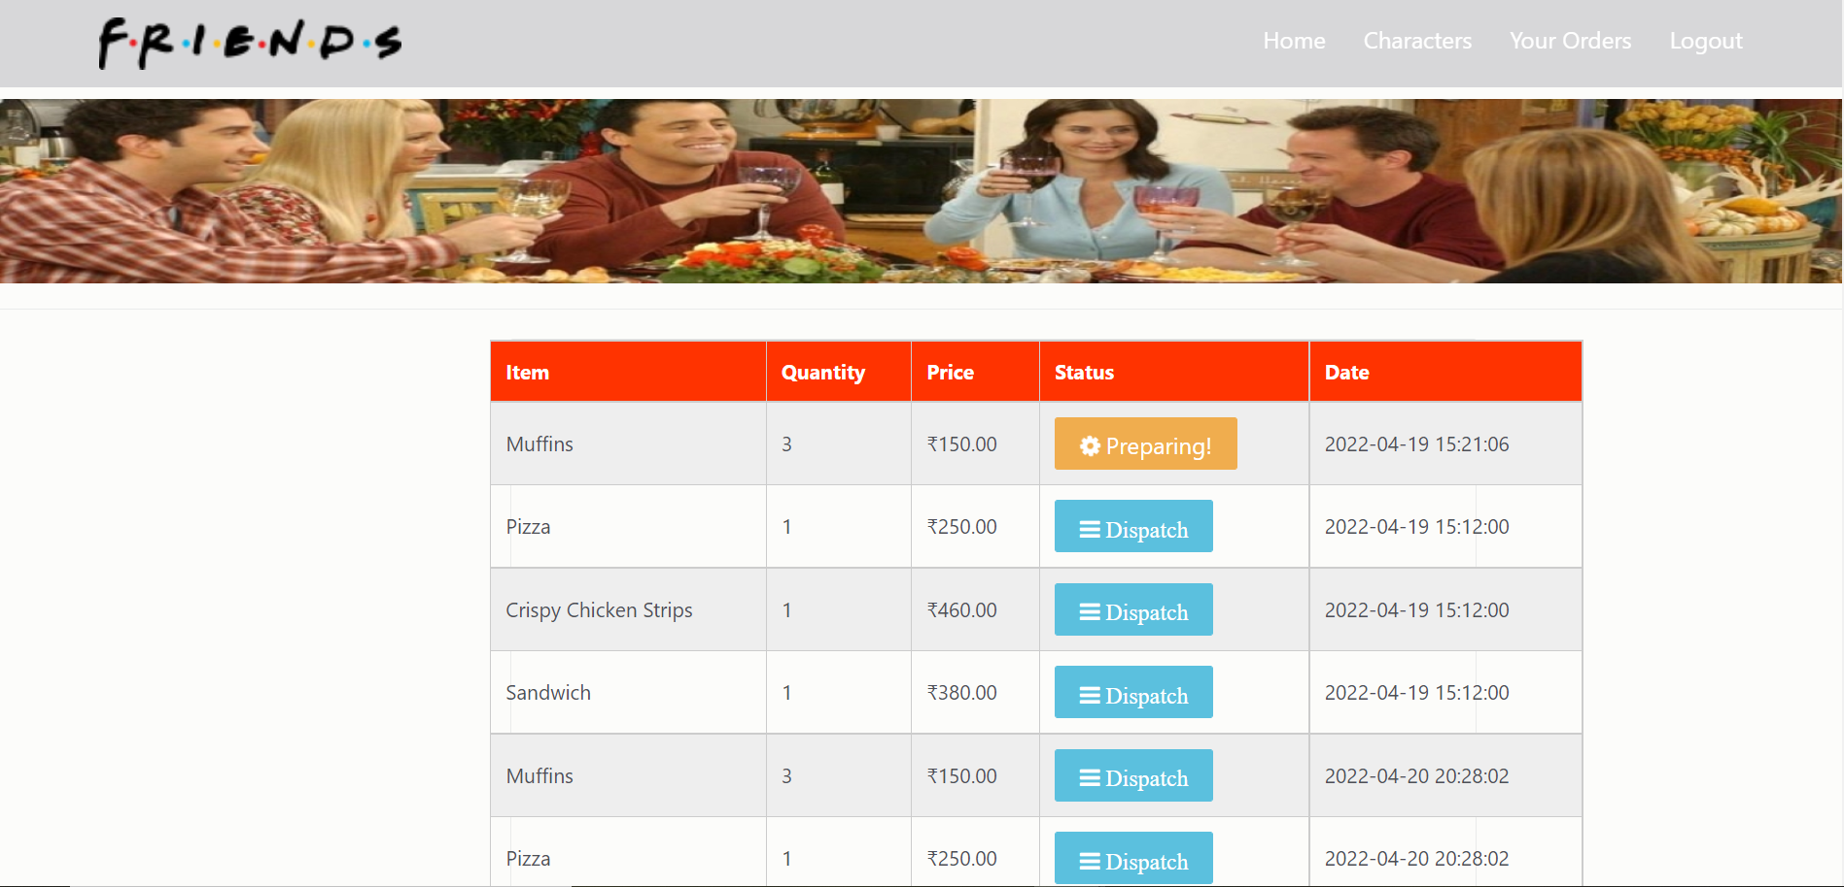
From Your Orders You Can View Your Previous Orders Along With The Currently Placed Order.
After Confirming The Order

Slide 9
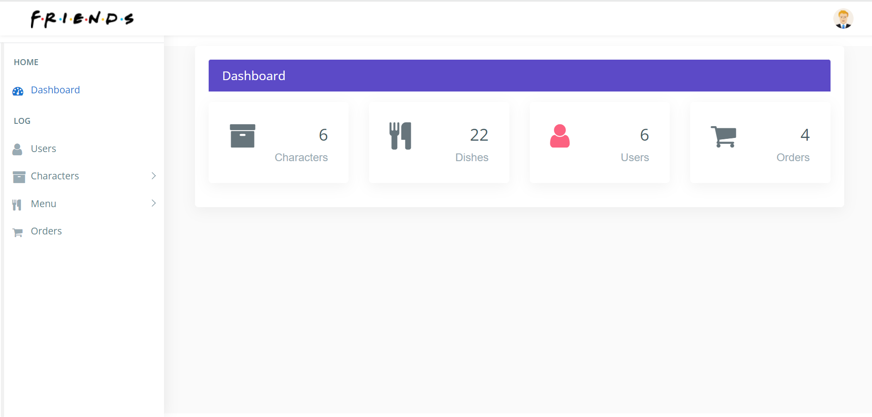
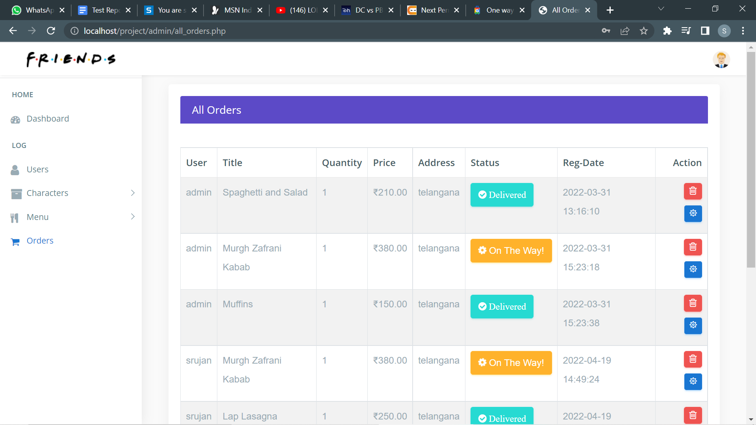
After Logging Into Admin Panel
Admin can update the status of the order

Slide 10
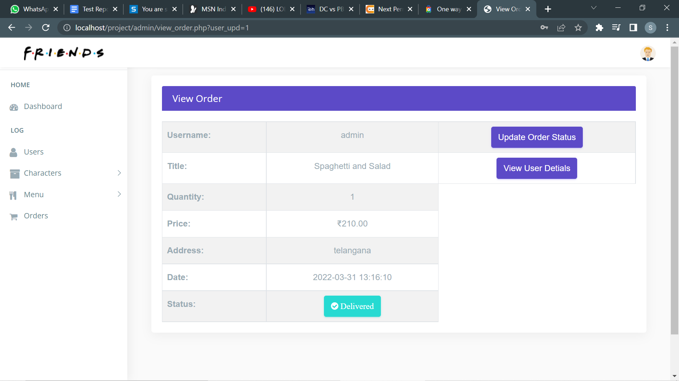
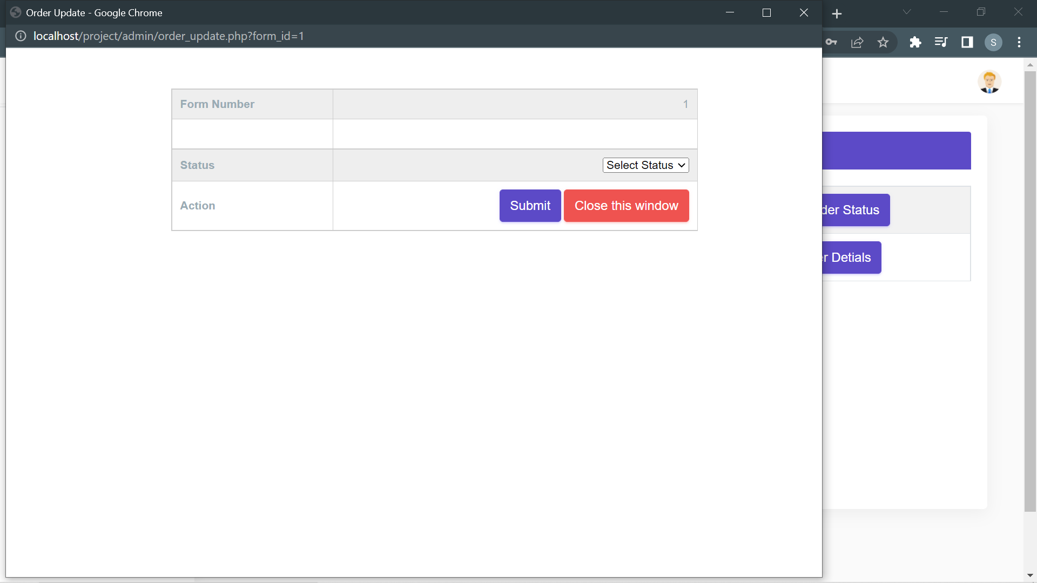
Admin Can Update The Status Of The Order

Slide 11
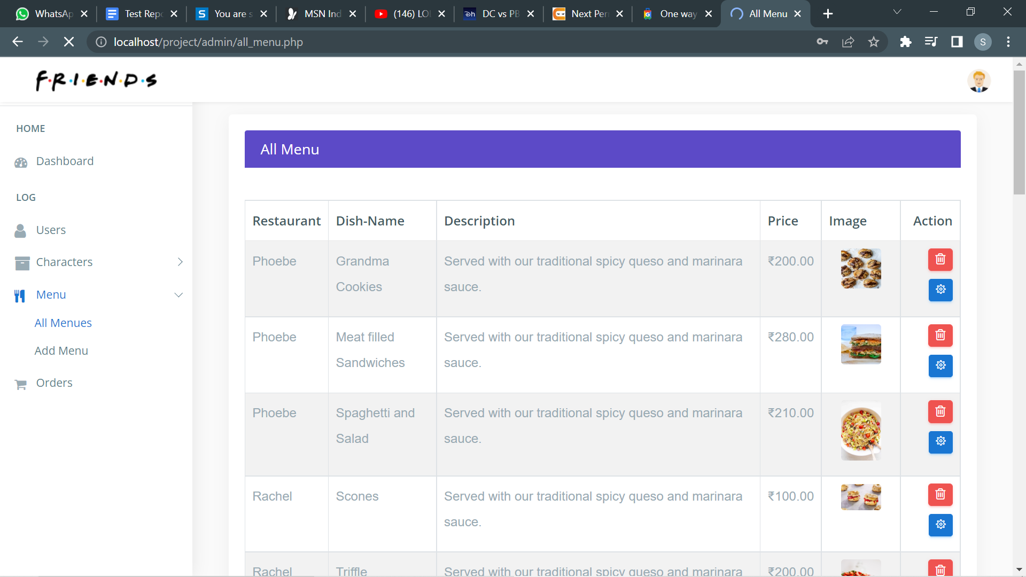
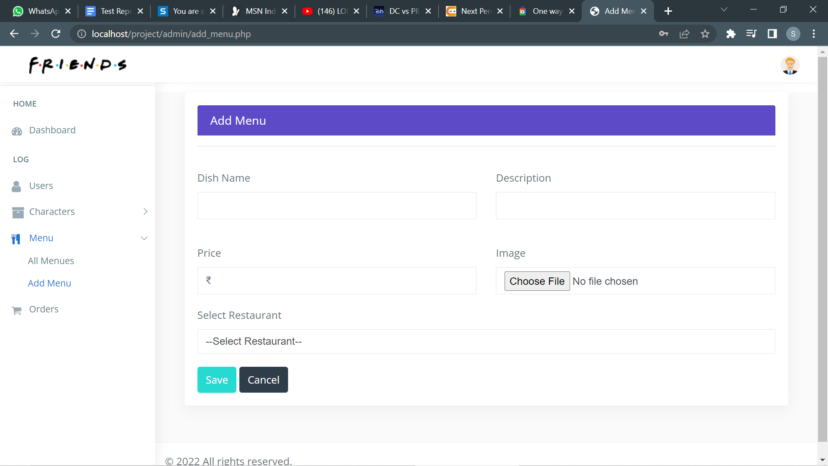
Admin can add and remove dishes from the menu

Slide 12

Thank You
Amaresh Chaudhary Nara(1901020)
Badagala Sriharsha(1901050)
Charitha Ram Nirmal Kondru(1901054)
Srujan Chikke(1901055)

